Slide 1

Web Development & Design Foundations with HTML5
Tenth Edition
Chapter 2
HTML Basics
Copyright © 2021, 2019, 2017 Pearson Education, Inc. All Rights Reserved

Slide 2
Learning Outcomes (1 of 2)
In this chapter, you will learn how to ...
Describe HTML, XHTML, and HTML5
Identify the markup language in a web page document
Use the html, head, body, title, and meta elements to code a template for a web page
Configure the body of a web page with headings, paragraphs, line breaks, divs, lists, and blockquotes
Configure text with phrase elements

Slide 3
Learning Outcomes (2 of 2)
Configure a web page using structural elements including header, nav, main, footer, section, aside, and article elements
Configure special characters
Use the anchor element to link from page to page
Create absolute, relative, and e-mail hyperlinks
Code, save, and display a web page document
Test a web page document for valid syntax

Slide 4
What is HTML?
HTML: The set of markup symbols or codes placed in a file intended for display on a Web browser page.
The World Wide Web Consortium (http://w3c.org) sets the standards for HTML and its related languages.

Slide 5
HTML Elements
Each markup code represents an HTML element.
Each element has a purpose. Most elements are coded as a pair of tags: an opening tag and a closing tag.
Tags are enclosed in angle brackets, “<” and ”>” symbols.

Slide 6

What is HTML5 ?
Newest version of HTML/XHTML
Supported by modern browsers
Intended to be backwards compatible
Adds new elements
Adds new functionality
Edit form data
Native video and audio
And more!
Source: W3C http://www.w3.org/html/logo/

Slide 7
Document Type Definition
Document Type Definition (DTD)
doctype statement
identifies the version of HTML contained in your document.
placed at the top of a web page document
<!DOCTYPE html>

Slide 8
Example HTML5 Web Page
<!DOCTYPE html>
<html lang=“en”>
<head>
<title>Page Title Goes Here</title>
<meta charset=“utf-8”>
</head>
<body>
... body text and more HTML5 tags go here ...
</body>
</html>

Slide 9
Head & Body Sections
Head Section Contains information that describes the web page document
<head>
…head section info goes here
</head>
Body Section Contains text and elements that display in the web page document <body>
…body section info goes here
</body>

Slide 10
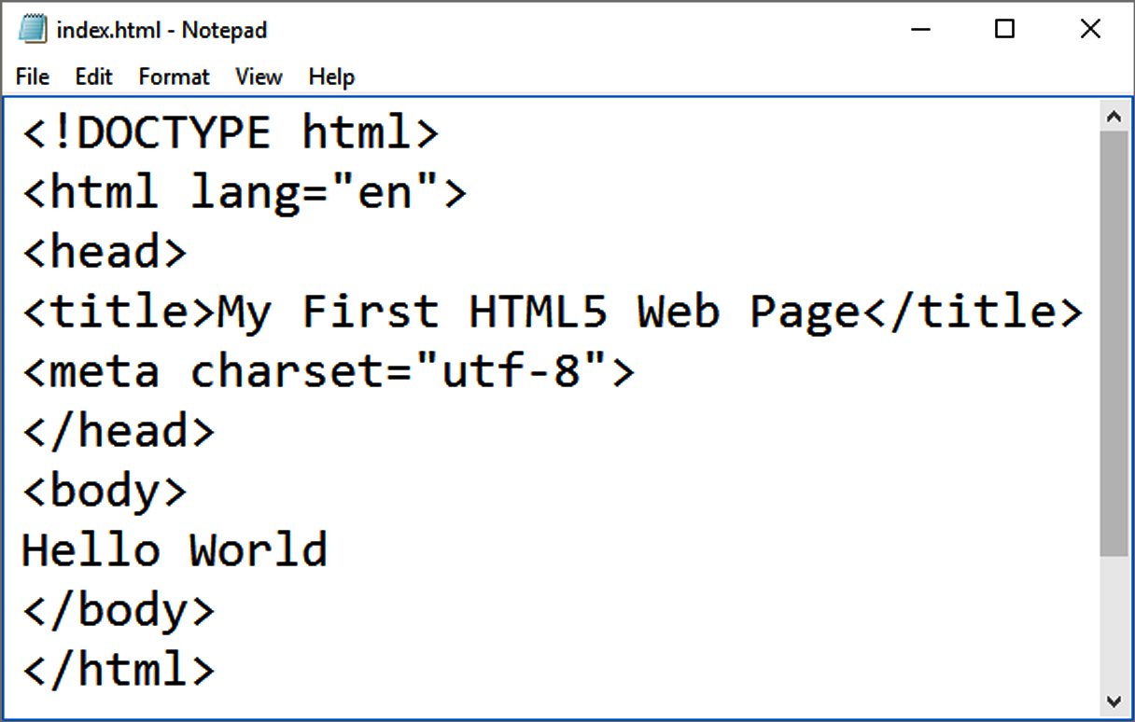
Figure 2.3 Code displayed in Notepad. Courtesy of Microsoft Corporation.
Title Element Meta Element

Slide 11
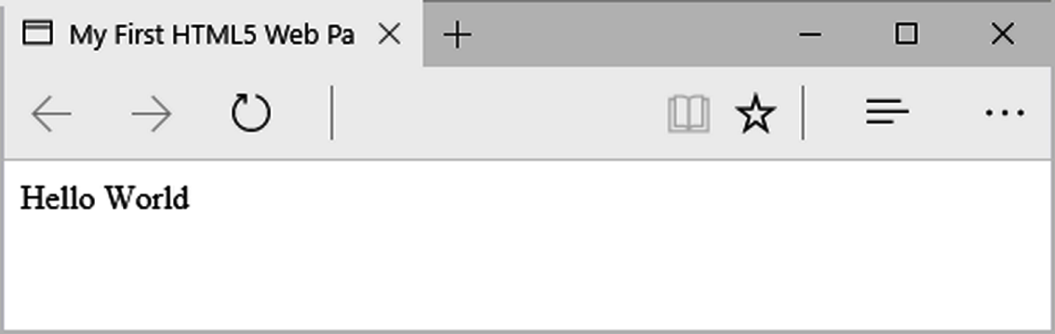
Figure 2.5 Web page displayed by Microsoft Edge. Courtesy of Microsoft Corporation.

Slide 12
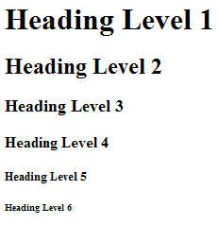
Heading Element
<h1>Heading Level 1</h1>
<h2>Heading Level 2</h2>
<h3>Heading Level 3</h3>
<h4>Heading Level 4</h4>
<h5>Heading Level 5</h5>
<h6>Heading Level 6</h6>

Slide 13
Paragraph Element
Paragraph element
<p> …paragraph goes here… </p>
Groups sentences and sections of text together.
Block Display – Configures empty space above and below

Slide 14
Line Break Element
Line Break element
Stand-alone, or void tag
…text goes here <br> This starts on a new line….
Causes the next element or text to display on a new line

Slide 15
Blockquote Element
Blockquote element
Indents a block of text for special emphasis
<blockquote>
…text goes here…
</blockquote>
Block Display – Configures empty space above and below

Slide 16
Table 2.1 Phrase Elements
Indicate the context and meaning of the text
Element | Example | Usage
<b> | bold text | Text that has no extra importance but is styled in bold font by usage and convention
<em> | emphasized text | Causes text to be emphasized in relation to other text; usually displayed in italics
<i> | italicized text | Text that has no extra importance but is styled in italics by usage and convention
<mark> | mark text | Text that is highlighted in order to be easily referenced (HTML5 only)
<small> | small text | Legal disclaimers and notices (“fine print”) displayed in small font-size
<strong> | strong text | Strong importance; causes text to stand out from surrounding text; usually displayed in bold
<sub> | _{sub} text | Displays a subscript as small text below the baseline
<sup> | ^{sup} text | Displays a superscript as small text above the baseline
Notes:
Phrase elements are displayed right in line with the other text.

Slide 17
Proper Nesting
CODE:
<p><i>Call for a free quote for your web development needs: <strong>888.555.5555 </strong></i></p>
BROWSER DISPLAY:
Call for a free quote for your web development needs: 888.555.5555

Slide 18
HTML Lists
Unordered List
Ordered List
Description List

Slide 19
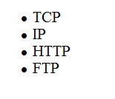
Unordered List
Displays a bullet, or list marker, before each entry in the list.
<ul> Contains the unordered list
<li> Contains an item in the list

Slide 20
Unordered List Example
<ul>
<li>TCP</li>
<li>IP</li>
<li>HTTP</li>
<li>FTP</li>
</ul>

Slide 21
Ordered List
Displays a numbering or lettering system to itemize the information contained in the list
<ol> Contains the ordered list
type attribute determines numbering scheme of list, default is numerals
<li> Contains an item in the list

Slide 22
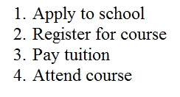
Ordered List Example
<ol>
<li>Apply to school</li>
<li>Register for course</li>
<li>Pay tuition</li>
<li>Attend course</li>
</ol>

Slide 23
Description List
Useful to display a list of terms and descriptions or a list of FAQ and answers
<dl> Contains the description list
<dt> Contains a term/phrase/sentence Configures empty space above and below the text
<dd>
Contains a description of the term/phrase/sentence
Indents the text
Configures empty space above and below the text

Slide 24
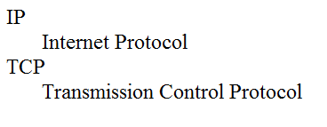
Description List Example
<dl>
<dt>IP</dt>
<dd>Internet Protocol</dd>
<dt>TCP</dt>
<dd>Transmission Control Protocol</dd>
</dl>

Slide 25
Checkpoint
Describe the features of a heading element and how it configures the text.
Describe the difference between ordered lists and unordered lists.
Describe the purpose of the blockquote tag.

Slide 26
Special Characters
Display special characters such as quotes, copyright symbol, etc.
Character | Code
© | &copy;
< | &lt;
> | &gt;
& | &amp;
 | &nbsp;
Also see Table 2.3

Slide 27
Div Element
Configures a structural block area or “division” on a web page with empty space above and below.
Can contain other block display elements, including other div elements
<div>Home Services Contact</div>

Slide 28
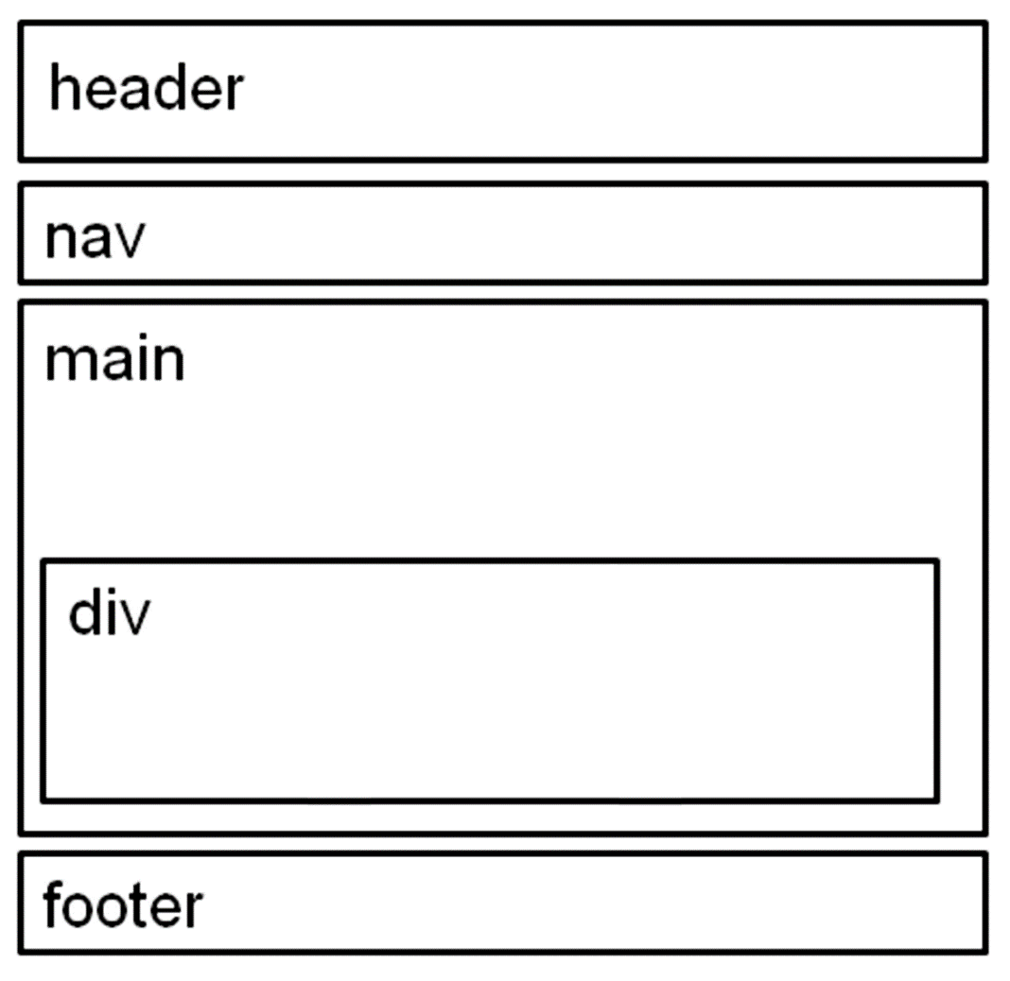
Figure 2.20 Wireframe for Casita Sedona

Slide 29
HTML5 Structural Elements (1 of 3)
header Element
<header></header> Contains the web page document’s headings
nav Element
<nav></nav> Contains web page document’s main navigation

Slide 30
HTML5 Structural Elements (2 of 3)
main Element <main></main> Contains the web page document’s main content
footer Element
<footer></footer> Contains the web page document’s footer

Slide 31
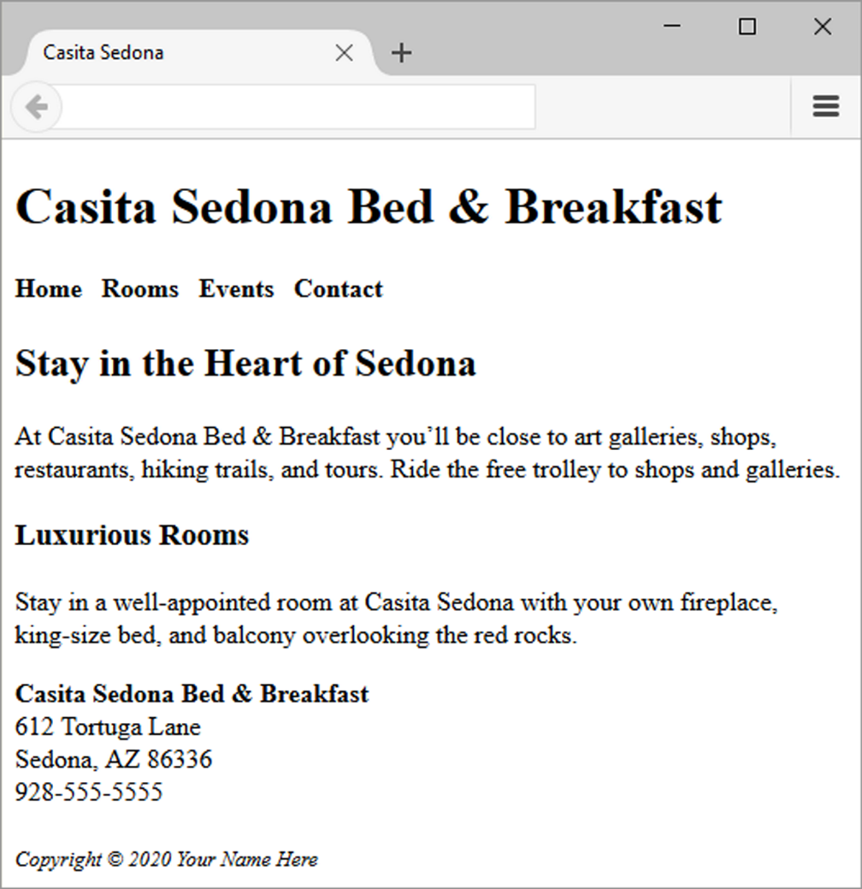
Figure 2.21 Casita Sedona web page

Slide 32
HTML5 Structural Elements (3 of 3)
<body>
<header> document headings go here </header>
<nav> main navigation goes here </nav>
<main> main content goes here </main>
<footer> document footer information goes here </footer>
</body>

Slide 33
More Structural Elements (1 of 2)
Aside Element
block display; contains a sidebar, a note, or other tangential content
Section Element
contains a “section” of a document, such as a chapter or topic
block display

Slide 34
More Structural Elements (2 of 2)
Article Element
contains an independent entry, such as a blog posting, comment, or e-zine article that could stand on its own
block display
Time Element
represents a date or a time
could be useful to date articles or blog posts
inline display

Slide 35
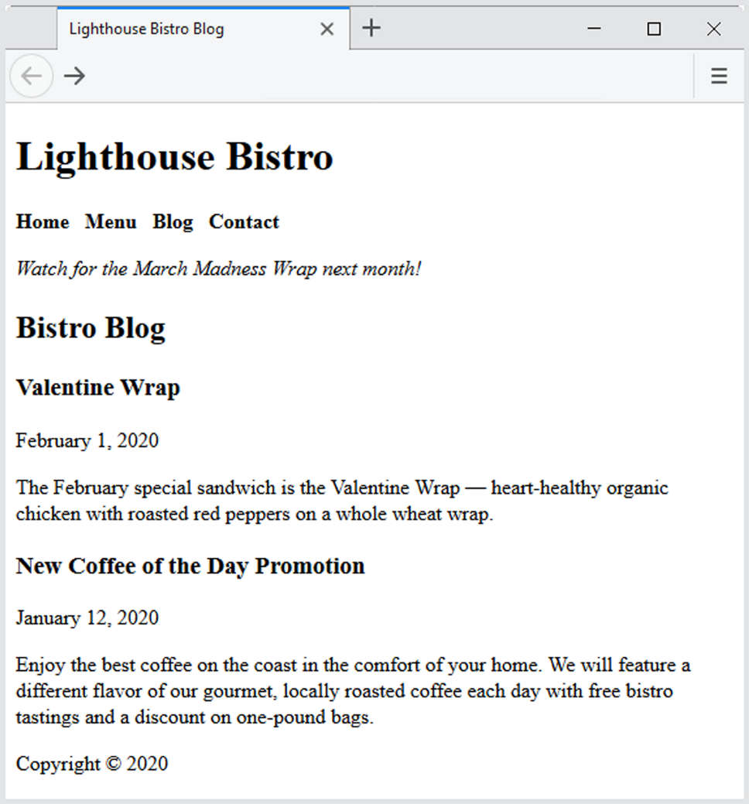
Figure 2.22 The blog page.

Slide 36
A Element (Anchor Element)
Specifies a hyperlink reference (href) to a file
Text between the <a> and </a> is displayed on the web page.
<a href="contact.html">Contact Us</a>
href Attribute
Indicates the file name or URL

Slide 37
Opening a Link in a New Browser Window
The target attribute on the anchor element opens a link in a new browser window or new browser tab.
<a href="https://google.com" target="_blank">Search Google</a>

Slide 38
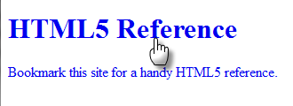
HTML5 Block Anchor
Configure block display elements within a hyperlink
<a href="http://www.w3.org/TR/html-markup">
<h1>HTML5 Reference</h1>
<p>Bookmark this site for a handy HTML5 reference.</p>
</a>

Slide 39
Absolute & Relative Hyperlinks
Absolute link
Link to a different website
<a href="http://yahoo.com">Yahoo</a>
Relative link
Link to pages on your own site
<a href="index.htm">Home</a>

Slide 40
E-Mail Hyperlink
Automatically launch the default mail program configured for the browser
If no browser default is configured,
a message is displayed
<a href=“mailto:me@gmail.com”>me@gmail.com</a>

Slide 41
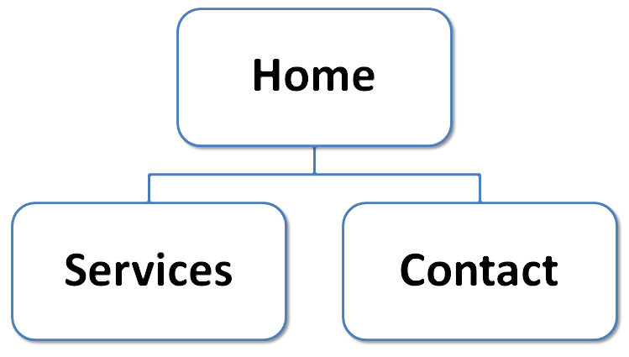
Hyperlinks
Hands-On Practice
Figure 2.24 Site map

Slide 42
Checkpoint (2 of 2)
Describe the purpose of special characters.
Describe when to use an absolute link. Is the http protocol used in the href value?
Describe when to use a relative link. Is the http protocol used in the href value?

Slide 43
Writing Valid HTML
Check your code for syntax errors
Benefit:
Valid code → more consistent browser display
W3C HTML Validation Tool
http://validator.w3.org

Slide 44
Summary
This chapter introduced you to HTML.
You will use these skills over and over again as you create web pages.

